Slide 1
Mobile Health:
Human Activity Recognition
DSA Internal Project
Group 4
Elly, Jeriel, Shaniah, Ziyan,
Harshini

Slide 2
Table of Content
Introduction
1
Problem Statement, Goal, Dataset Summary
2
Exploratory Dataset Analysis
Artificial Intelligence
3
Machine Learning and Deep Learning Model
4
Conclusion
Generative AI
5
Creation of Gradio UI

Slide 3
01
Introduction
Shaniah

Slide 4
Imagine taking care of a family member’s mobility health
Notes:
Before we dive into our solution, let’s first understand what is our problem. Our problem concerns healthcare professionals that juggle with patients, multiple patients in assisting with their mobility health. To make it more relatable, imagine taking care of our grandparents, great grandparents all the time. overtime it will get difficult in keeping track of their activities. Our problem is …

Slide 5
How to keep track and be informed about patient’s mobility health
Notes:
how do healthcare professionals monitor various patients mobility and overall health ?

Slide 6
Accurately Determine Human Activity
How can we improve activity tracking to make it more adaptable to different people and situations, and capable of delivering quick, reliable results?
Notes:
Our solution leverages human activity recognition , utilizing sensors that accurately track patients movement, empowering care providers with valuable insights for better patient care

Slide 7
Problem Statement
Individuals in healthcare settings, such as physiotherapists or elderly care providers, would benefit from an automated system that accurately classifies human activities using wearable sensor data. The system should provide real-time insights into activities, aiding in the monitoring of patient mobility and overall health.
The goal is to create a machine learning pipeline that can process accelerometer and gyroscope data and classify activities accurately, enabling healthcare providers to make informed decisions about patient care.

Slide 8
Background
2 Sensors on
2 Body Parts
10 Subjects
13 Activities
Subjects with no other information provided
Accelerometer &
Gyroscope place on ankle and arm measuring X,Y,Z.
Various activities ranging in intensity and difficulty
Notes:
Our study involved 10 subjects performing 13 activities. Accelerometer and gyroscope sensors were used on the ankle and arm to capture their movements in 3D space.

Slide 9



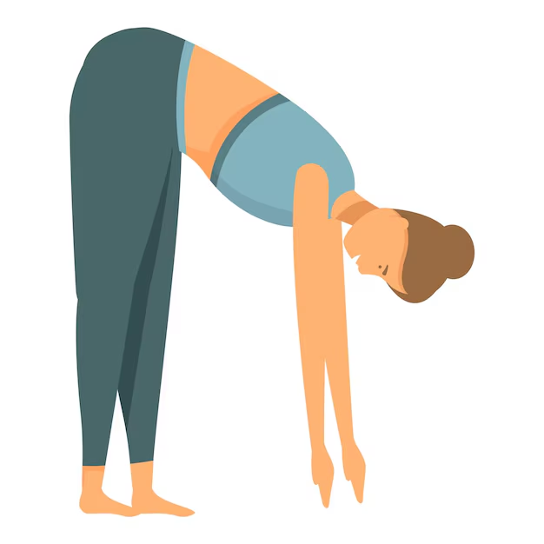


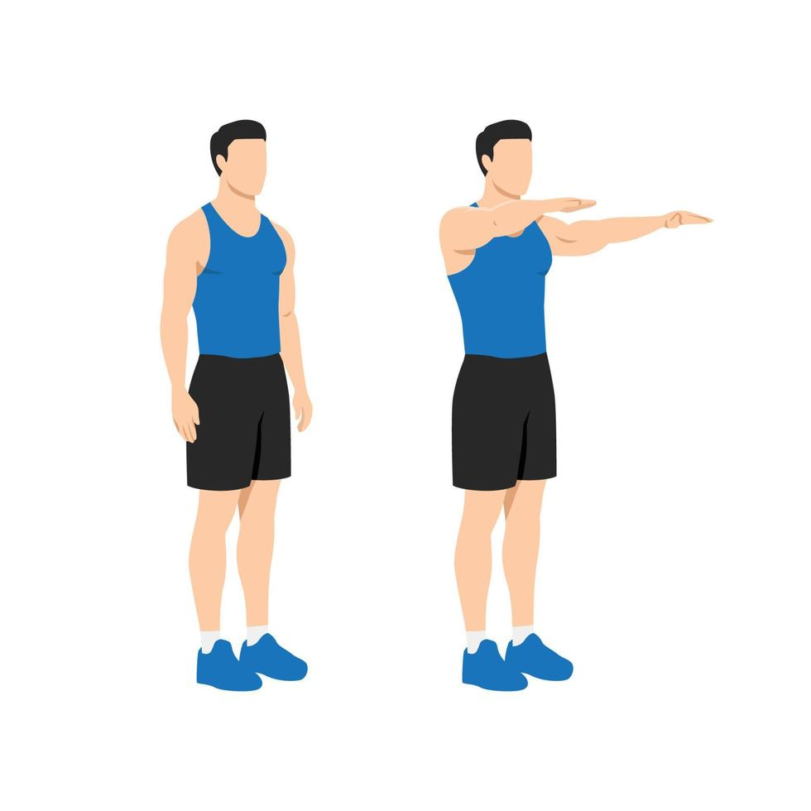
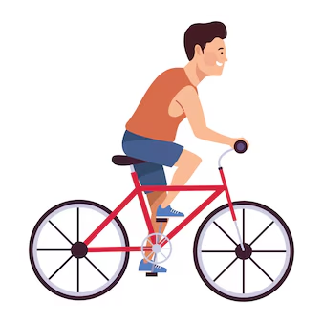
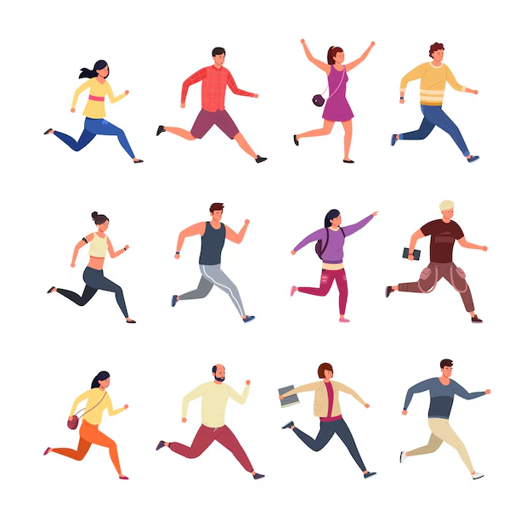


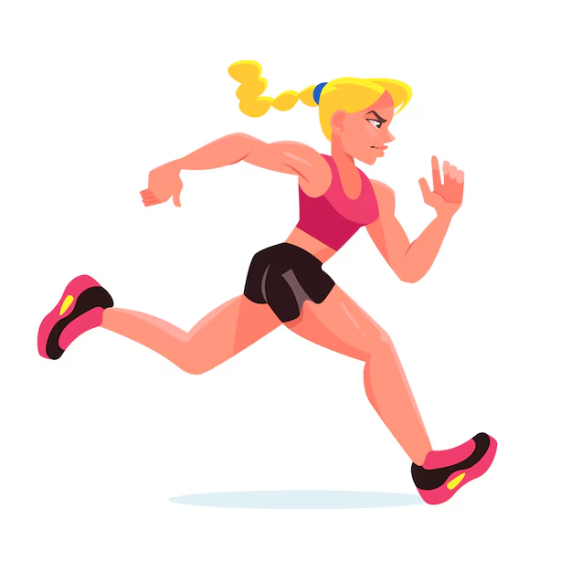
Activity
Standing still (1 min)
Sitting and relaxing (1 min)
Lying down (1 min)
Waist bends forward (20x)
Walking (1 min)
Climbing stairs (1 min)
Frontal elevation of arms (20x)
Knees bending (crouching) (20x)
Cycling
(1 min)
Jogging (1 min)
Jump front & back (20x)
Running (1 min)
Notes:
These are the 13 activities done by the subjects, the last 1 not mentioned in the slide, is the subject doing nothing.
#### Activities: 12
L1: Standing still (1 min)\
L2: Sitting and relaxing (1 min)\
L3: Lying down (1 min)\
L4: Walking (1 min)\
L5: Climbing stairs (1 min)\
L6: Waist bends forward (20x)\
L7: Frontal elevation of arms (20x)\
L8: Knees bending (crouching) (20x)\
L9: Cycling (1 min)\
L10: Jogging (1 min)\
L11: Running (1 min)\
L12: Jump front & back (20x)

Slide 10
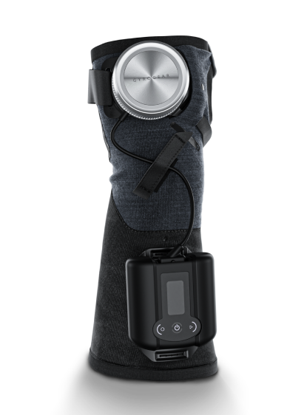
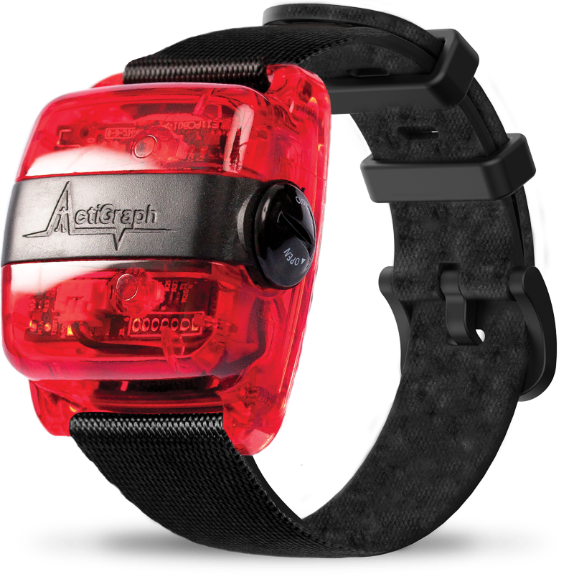
2 Sensors
Accelerometer
Gyroscope
Notes:
The movements of the subject is captured using an accelerometer, which measures the acceleration, In simple terms, accelerometer is like a tilt sensor, it tells if the arm or ankle is moving up, down, left and right and gyroscope measures the rotational velocity, that tells if something is rotating or twisting.
Explain what the sensors are, what do they variables they store and how it is stored.

Slide 11
02
Exploratory
Data Analysis
Elly

Slide 12
Sample of Mhealth Dataset
Subject | Activity | alx | aly | alz | glx | gly | …
0 | 0 | 2.1849 | -9.6967 | 0.63077 | 0.103900 | -0.84053 | …
1 | 1 | 2.3876 | -9.5080 | 0.68389 | 0.085343 | -0.83865 | …
2 | 2 | 2.4086 | -9.5674 | 0.68113 | 0.085343 | -0.83865 | …
3 | 3 | 2.1814 | -9.4301 | 0.55031 | 0.085343 | -0.83865 | …
4 | 4 | 2.4173 | -9.3889 | 0.71098 | 0.085343 | -0.83865 | …
… | … | … | … | … | … | … | …
Notes:
This is the results of the experiments, so each of the findings

Slide 13
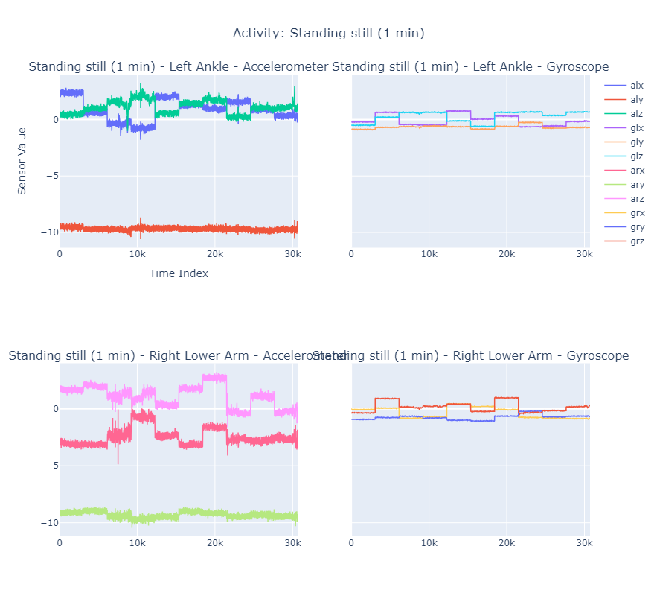
Example of Readings
(A) from Accelerometer
(G) from Gyroscope
(L) Left Ankle
(R) Right Lower Arm
Accelerometer Measures linear acceleration along 3 axes:
X : Left-to-right movement (horizontal axis).
Y : Front-to-back movement (vertical axis).
Z : Up-and-down movement (gravity-related axis).
Gyroscope Measures angular velocity (rotation rate) around 3 axes:
X : Rotation around the horizontal axis (pitch).
Y : Rotation around the vertical axis (yaw).
Z : Rotation around the front-to-back axis (roll).
(alx)
Accelerometer Left Ankle X axis
Notes:
As you can see there are some random letters here. So what do they mean? The letters basically help us identify the different types of readings.
corr_matrix = df.iloc[:, 0:-2].corr()
# Convert the correlation matrix to a format Plotly can use
corr_matrix = corr_matrix.reset_index().melt(id_vars=['index'])
# Create the heatmap with Plotly
cm_fig = px.imshow(corr_matrix.pivot(index='index', columns='variable', values='value'),
color_continuous_scale='RdBu_r',
labels={'index': 'Features', 'variable': 'Features', 'value': 'Correlation'},
title="Correlation Heatmap")
cm_fig.update_layout(
xaxis_title='Features',
yaxis_title='Features',
title_x=0.5, # Center the title
)
cm_fig.show()

Slide 14
Data Processing Considerations
Size Imbalance
No null
Values
No duplicates
Activity readings are highly imbalanced
All values are filled
All rows are unique
Notes:
What data processing we need to do base on our findings ?
Base on our findings, our dataset is actually very clean but it is evident that there is an imbalance of observations on activities.

Slide 15
Resample Activity Size
Standardisation
Data Preparation
Separation of
Training and Testing
Pipeline
Undersampled data for each activity to 30,720
Used feature scaling to tackle potential missing values
Transforming > Validation > Featurizing
Sensor Inputs
Activity
Notes:
What we actually diid for data processing ?
So we resampled the activity sizes to be similar which is 30 720,
We separated our training and testing variables where, sensor are the inputs and the results are the activity
Then we standardized our training and testing sets for modelling.
We also created a pipeline that we would be using to deal with any null values for new inputs that have missing inputs.

Slide 16
Data Visualisations

Slide 17
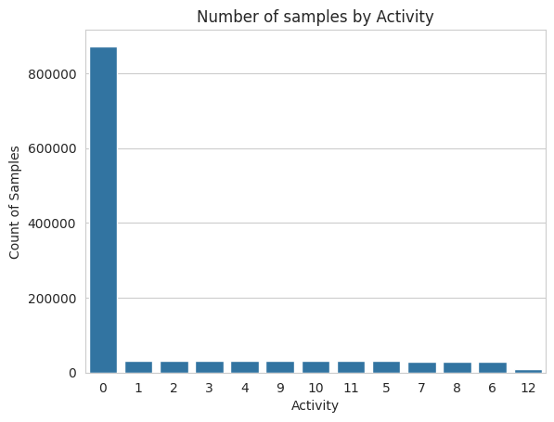
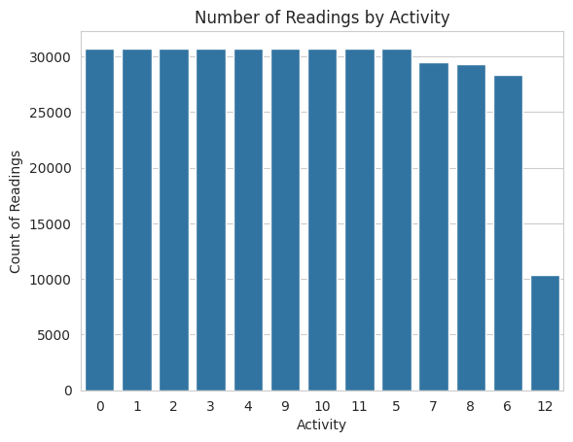
Number of Samples by Activity
Before
After
Notes:
Earlier on we mentioned an imbalance in our data set and the need for undersampling. This slide basically shows why we did that. As you can see, activity 0 has an abnormal
# bar plot for visualisation of corrected activity ditribution
sns.set_style("whitegrid")
sns.countplot(x='Activity', data = df, order = df['Activity'].value_counts().index)
plt.title('Number of samples by Activity')
plt.xlabel('Activity')
plt.ylabel('Count of Samples')
plt.show()

Slide 18
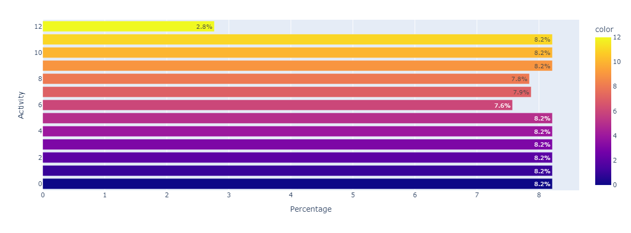
Activity Readings Distribution
Notes:
def plot_category(df, cat):
"""
Creates a horizontal bar plot to visualize the percentage distribution of a categorical variable.
Parameters:
- df: DataFrame containing the data.
- cat: Categorical column name to visualize.
"""
# Calculate the percentage distribution
array = (df[cat].value_counts().sort_values(ascending=False) / len(df)) * 100
# Convert the percentage values to string format with a '%' symbol
# text_values = array.values.round(1).astype(str) + '%' # Original line causing error
# The correct way to add '%' is to use list comprehension and format strings:
text_values = [f'{x:.1f}%' for x in array.values]
# Create the bar chart using Plotly Express
cat_fig = px.bar(
x=array.values, # Percentage values
y=array.index, # Category names
labels={'x': 'Percentage', 'y': cat}, # Axis labels
title=f'{cat} Distribution', # Plot title
text=text_values, # Add percentage text on bars
orientation='h', # Horizontal bar chart
color=array.index, # Color bars by category
color_discrete_sequence=px.colors.qualitative.Set3 # Set color palette
)
# Customize layout
cat_fig.update_layout(
title_x=0.5, # Center the title
height=500, # Set figure height
showlegend=False, # Hide the legend
xaxis_title='Percentage', # Label for x-axis
yaxis_title=cat, # Label for y-axis
)
# Display the chart
cat_fig.show()
plot_category(df, 'Activity')

Slide 19
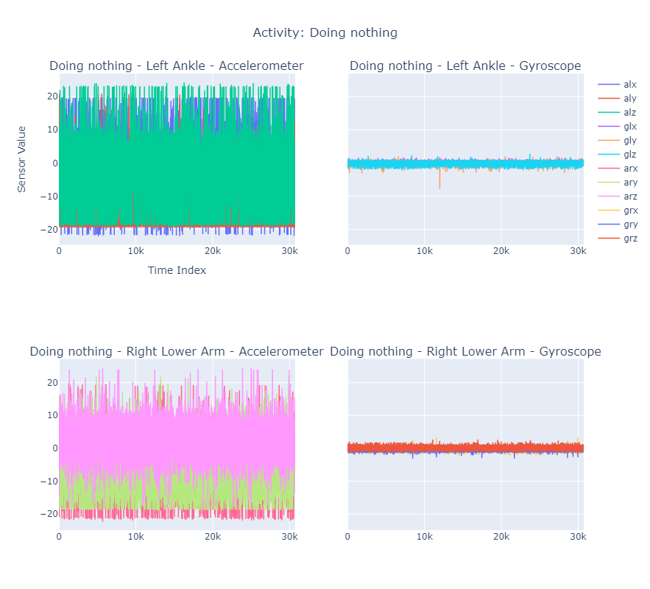
Baseline: Readings of sensors when doing nothing
Notes:
def plot_comparison_part1(df):
"""Plots the second half of activities (0 to 5)."""
# Define sensor groups for visualization
for i in range(0, 6): # Loop through activities 0 to 5
# Filter data for the current activity
activity_data = df[df['Activity'] == i]
# Check if there is no data for the current activity
if activity_data.empty:
print(f"No data available for Activity {i}. Skipping.")
continue
# Create a subplot for the current activity
com_fig = make_subplots(
rows=2, cols=2,
subplot_titles=[
f'{activity_map.get(i, f"Activity {i}")} - {sensor_name}' for sensor_name in sensors.keys()
],
shared_yaxes=True
)
for idx, (sensor_name, columns) in enumerate(sensors.items()):
row = (idx // 2) + 1
col = (idx % 2) + 1
for column in columns:
com_fig.add_trace(go.Scatter(
x=activity_data.reset_index(drop=True).index,
y=activity_data.reset_index(drop=True)[column],
mode='lines',
name=column,
line=dict(width=1.5)
), row=row, col=col)
# Update layout for each subplot
com_fig.update_layout(
title=f'Activity: {activity_map.get(i, f"Activity {i}")}',
title_x=0.5,
height=800,
xaxis_title='Time Index',
yaxis_title='Sensor Value',
showlegend=True
)
# Show the plot
com_fig.show()
plot_comparison_part1(df)

Slide 20
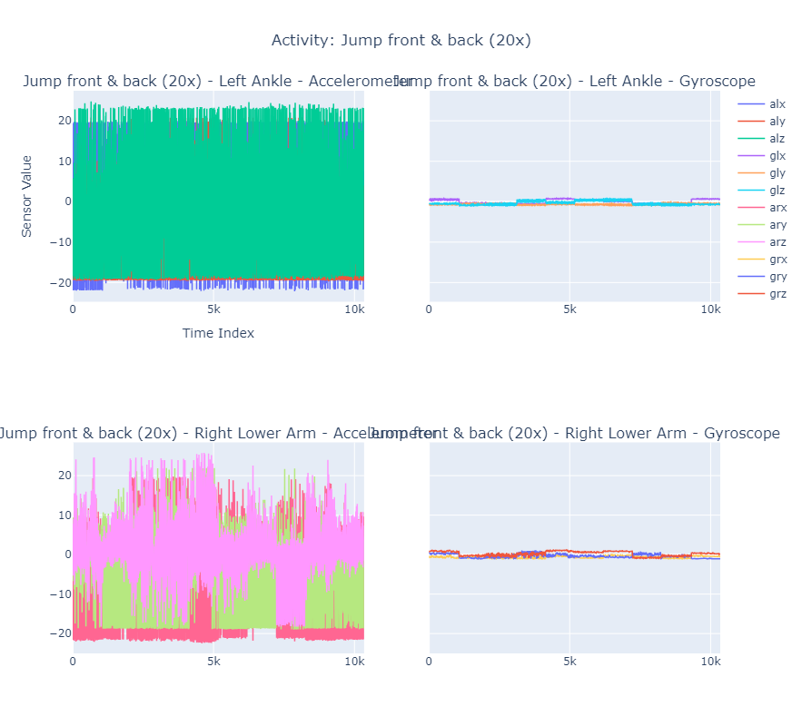
Standing Still
Jump Front & Back

Slide 21
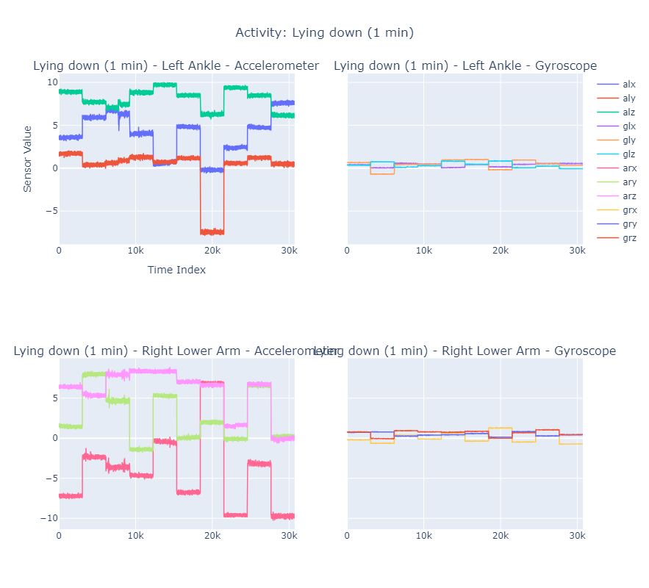
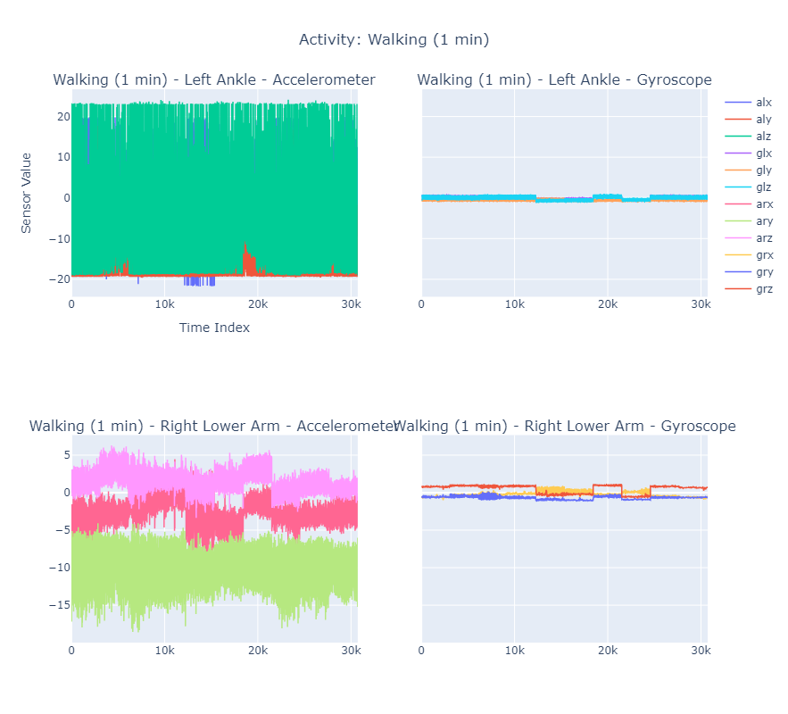
Lying Down
Walking

Slide 22
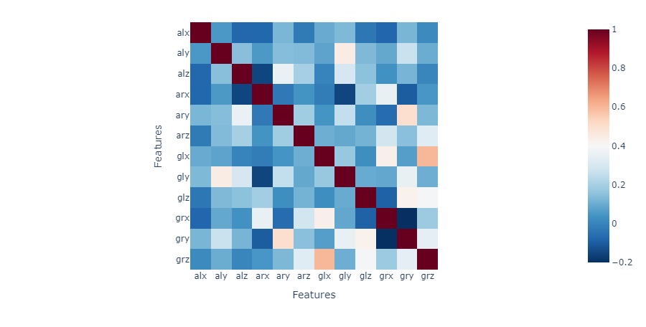
Telemetry Readings Correlation Map
Notes:
This code generates a correlation heatmap to visualize the relationships between different numerical features in the dataset (df), excluding the Activity and subject columns. # Create correlation matrix excluding Activity and subject
corr_matrix = df.iloc[:, 0:-2].corr()
# Convert the correlation matrix to a format Plotly can use
corr_matrix = corr_matrix.reset_index().melt(id_vars=['index'])
# Create the heatmap with Plotly
cm_fig = px.imshow(corr_matrix.pivot(index='index', columns='variable', values='value'),
color_continuous_scale='RdBu_r',
labels={'index': 'Features', 'variable': 'Features', 'value': 'Correlation'},
title="Correlation Heatmap")
cm_fig.update_layout(
xaxis_title='Features',
yaxis_title='Features',
title_x=0.5, # Center the title
)
cm_fig.show()

Slide 23
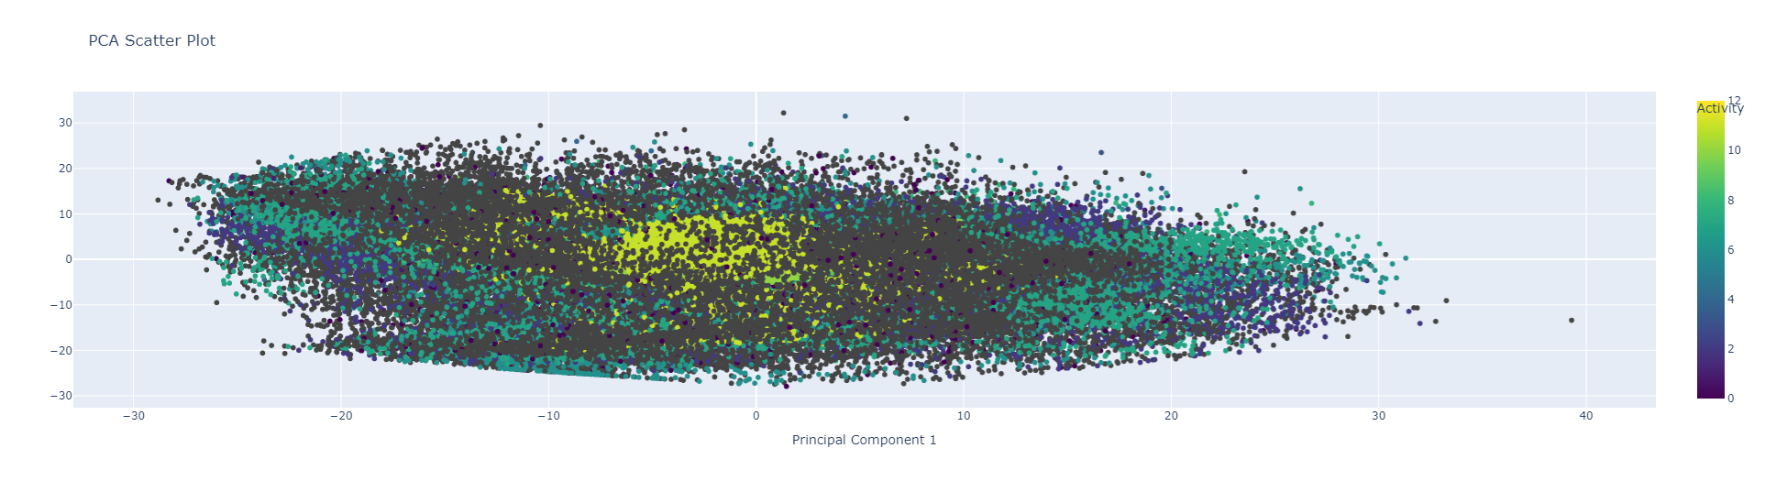
2D Representation of Sensor Data using PCA
Notes:
This code uses Principal Component Analysis (PCA) to reduce the high-dimensional sensor data (accelerometer and gyroscope measurements) to 2 principal components. It then visualizes the resulting low-dimensional representation in a scatter plot, color-coded by activity.
Purpose
Dimensionality Reduction:
PCA reduces high-dimensional data (e.g., accelerometer and gyroscope measurements) to just 2 dimensions while retaining most of the variance.
Helps simplify data visualization and analysis.
Activity Separation:
The scatter plot shows how well the reduced dimensions (PC1 and PC2) separate different activities.
Activities that cluster tightly in specific regions of the plot are likely distinguishable by the sensor data.
Feature Engineering:
PCA can
# PCA
#used here to reduce the dimensionality of sensor data (accelerometer and gyroscope measurements),making it easier to visualize and analyze activity patterns while preserving as much variance as possible.
#This allows for more efficient classification and feature extraction from the high-dimensional data.
X = df.drop(columns=['Activity', 'subject']) # Dropping Activity and subject columns for PCA
# Perform PCA (reduce to 2 components)
pca = PCA(n_components=2)
X_pca = pca.fit_transform(X)
pca_df = pd.DataFrame(data=X_pca, columns=['PC1', 'PC2'])
# Add the 'Activity' column back to the PCA dataframe
pca_df['Activity'] = df['Activity']
# Plotly Express scatter plot for PCA
pca_fig = px.scatter(pca_df, x='PC1', y='PC2', color='Activity',
title='PCA Scatter Plot',
labels={'PC1': 'Principal Component 1', 'PC2': 'Principal Component 2'},
color_continuous_scale='viridis')
# Show the plot
pca_fig.show()

Slide 24
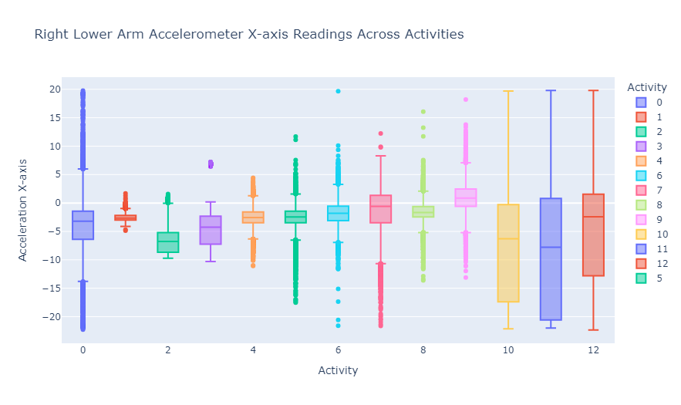
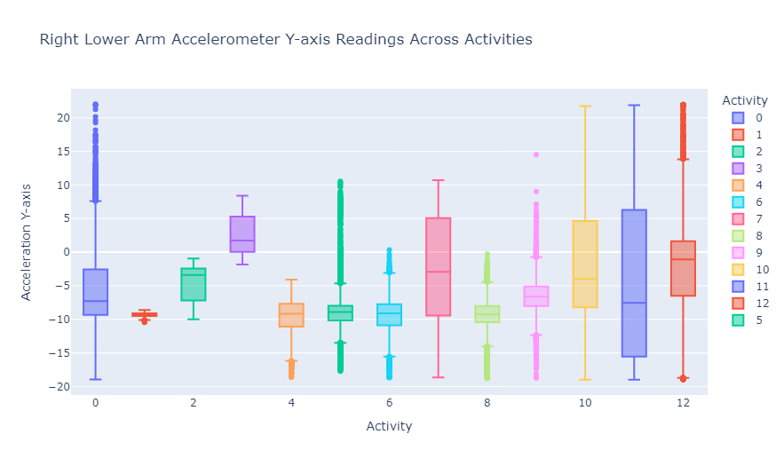
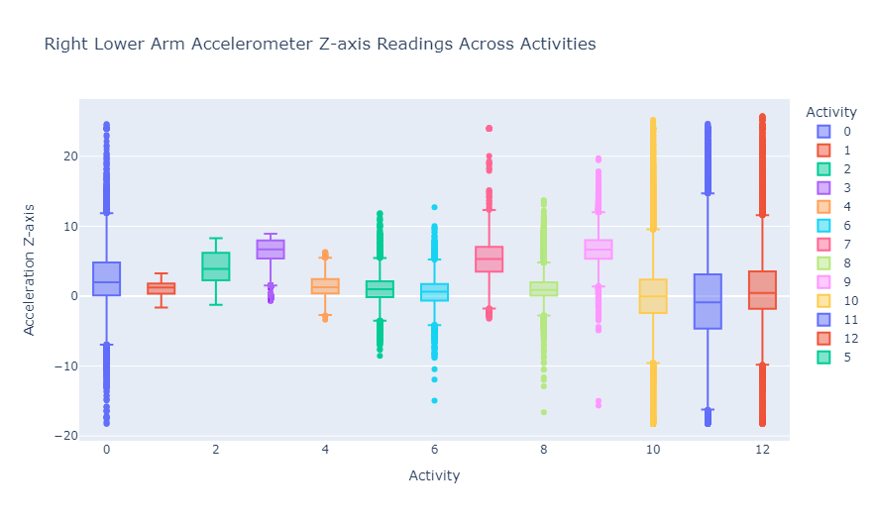
Right Lower Arm Accelerometer
Notes:
# Accelerometer for Arm
# Plot for each axis (e.g., 'arx', 'ary', 'arz')
fig7 = px.box(df, x='Activity', y='arx', color='Activity',
title="Right Lower Arm Accelerometer X-axis Readings Across Activities",
labels={'Activity': 'Activity', 'arx': 'Acceleration X-axis'})
fig8 = px.box(df, x='Activity', y='ary', color='Activity',
title="Right Lower Arm Accelerometer Y-axis Readings Across Activities",
labels={'Activity': 'Activity', 'ary': 'Acceleration Y-axis'})
fig9 = px.box(df, x='Activity', y='arz', color='Activity',
title="Right Lower Arm Accelerometer Z-axis Readings Across Activities",
labels={'Activity': 'Activity', 'arz': 'Acceleration Z-axis'})
# Show all the plots
fig7.show()
fig8.show()
fig9.show()

Slide 25
03
Artificial Intelligence (AI)
Machine Learning Models
Jeriel

Slide 26
Using AI
Machine Learning
Deep Learning
Pipelining
Classification Models
Human Activity Recognition
Neural Networks
Dimension Reduction
Anomaly Detection

Slide 27
Machine Learning

Slide 28
Classification Models
1
2
3
4
5
Logistic
Regression
Random Forest
Decision Trees
KNN
SVM

Slide 29
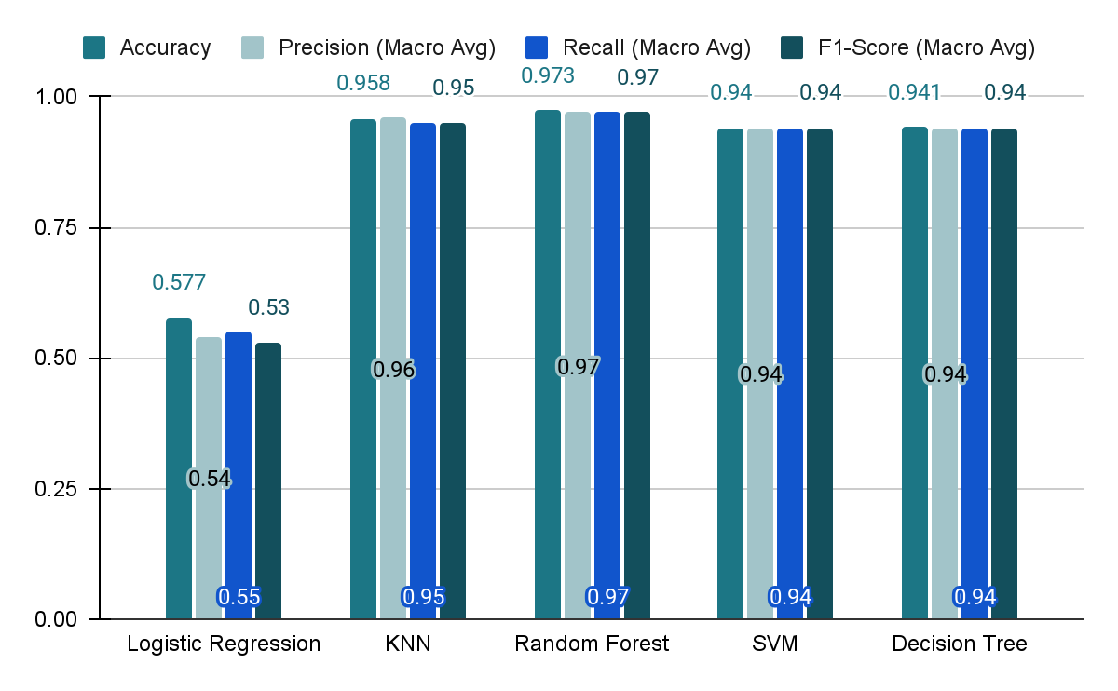
Performance Analysis
Correctness of true positive
Identification of true positive
Notes:
# bar plot for visualisation of corrected activity ditribution
sns.set_style("whitegrid")
sns.countplot(x='Activity', data = df, order = df['Activity'].value_counts().index)
plt.title('Number of samples by Activity')
plt.xlabel('Activity')
plt.ylabel('Count of Samples')
plt.show()

Slide 30
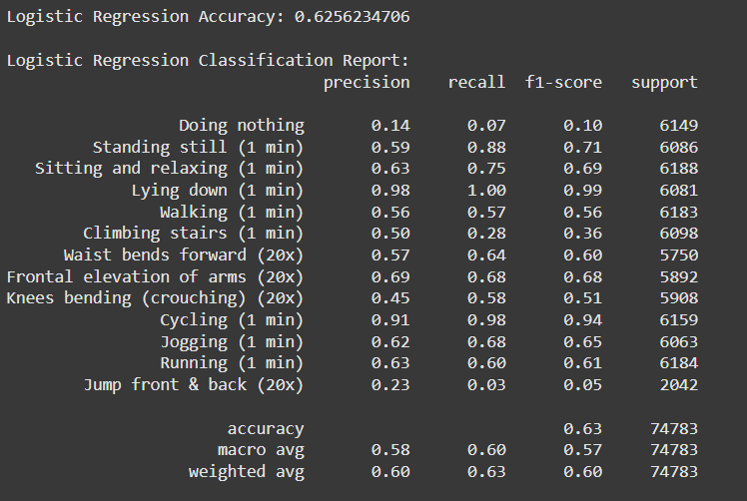
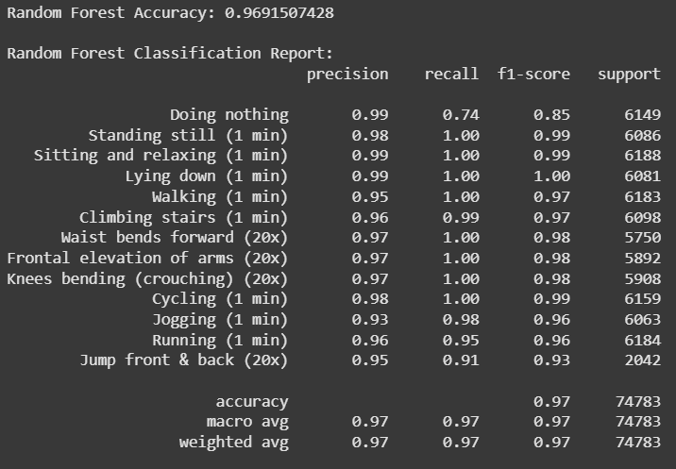
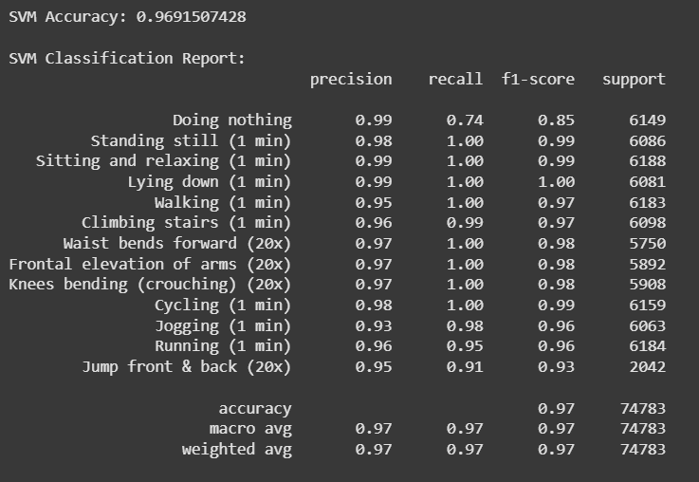
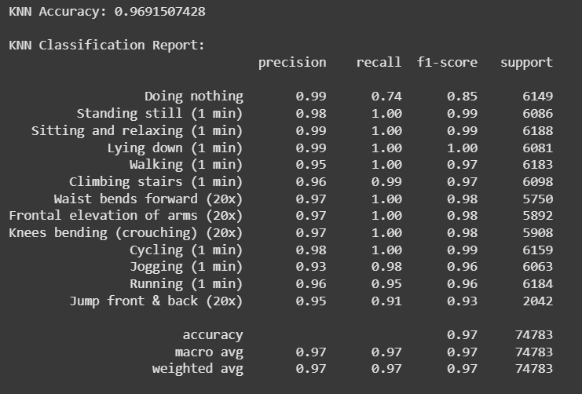
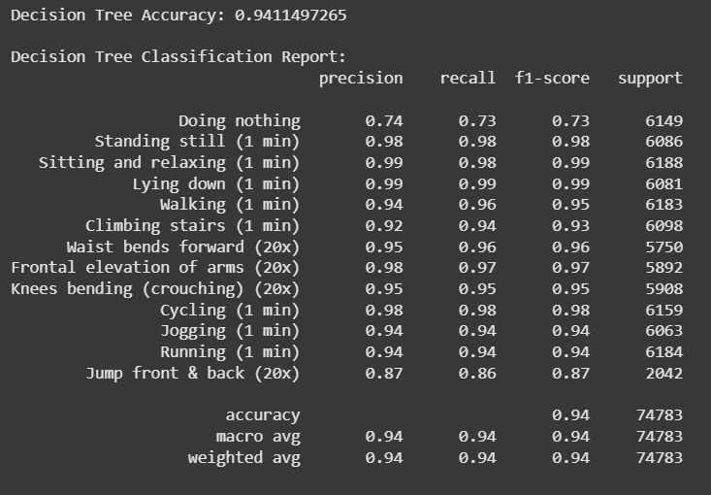
Accuracy and Classification Report ( Before HPT)
Notes:
# bar plot for visualisation of corrected activity ditribution
sns.set_style("whitegrid")
sns.countplot(x='Activity', data = df, order = df['Activity'].value_counts().index)
plt.title('Number of samples by Activity')
plt.xlabel('Activity')
plt.ylabel('Count of Samples')
plt.show()

Slide 31
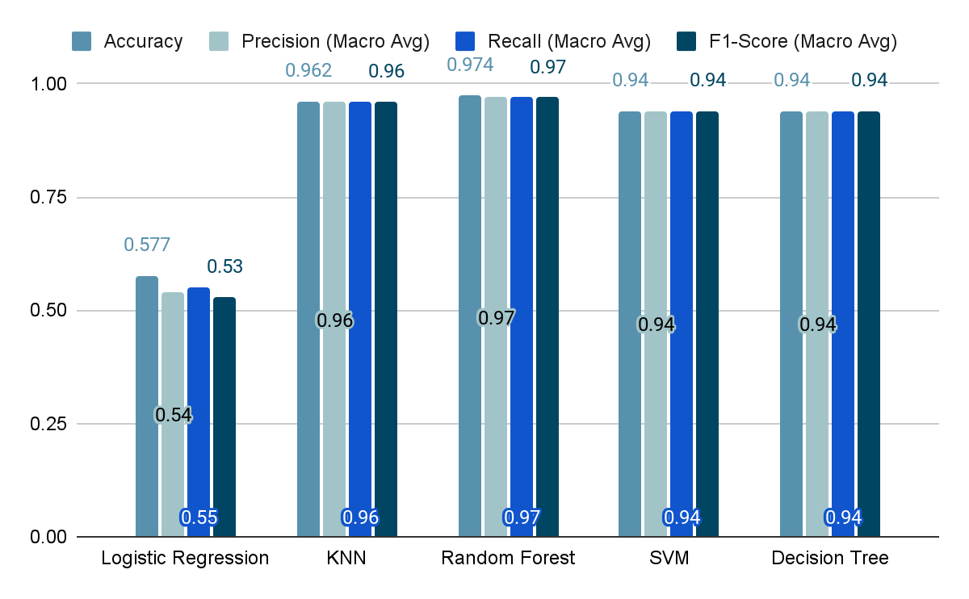
Performance Analysis After Tuning
Notes:
plt.figure(figsize = (30,10))
sns.countplot(x = 'subject', hue = 'Activity', data = df)
plt.title('Activities by Users')
plt.tight_layout()
plt.show()

Slide 32
Deep Learning

Slide 33
Deep Learning Models
1
2
3
Convolutional Neural Networks (CNN)
Deep Neural Networks (DNN)
CNN & Long Short Term- Memory (LSTM)
Notes:
Shaniah

Slide 34
Results Analysis
Model | Test loss | Test accuracy
CNN | 21% | 93.5%
CNN & LSTM | 20% | 94.3%
DNN | 33% | 89.1%
Notes:
Convolutional Neural Network
0.21791578829288483
0.9350119829177856
Convolutional Neural Network
Long Short Term Memory
0.19594848155975342
0.9430351853370667
Deep Neural Network
0.33358830213546753
0.8911784887313843

Slide 35
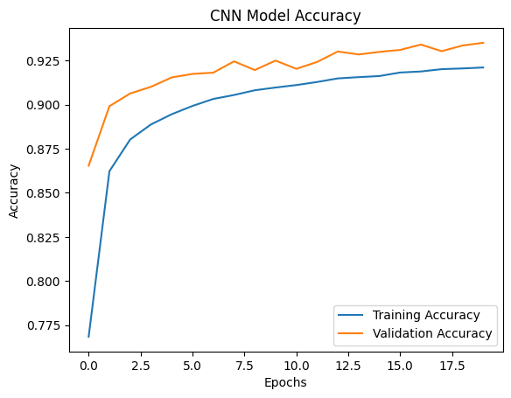
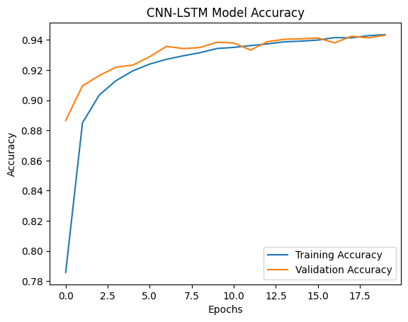
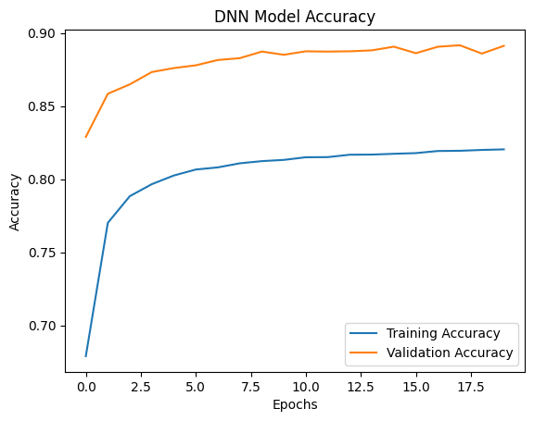
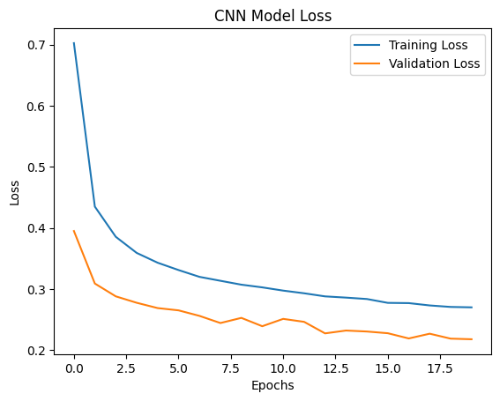
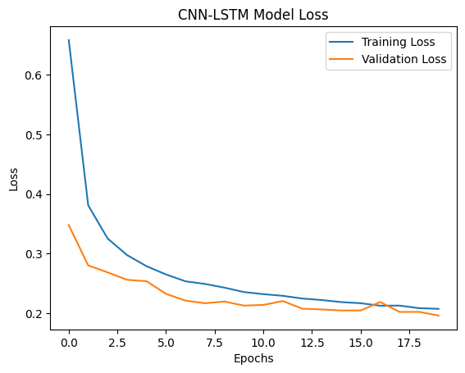
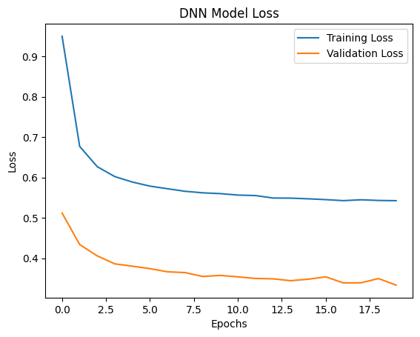
Results Analysis

Slide 36
Anomaly Detection Model
Isolation Forest
94.3%
CNN + LSTM
Notes:
Choose cnn+lstm as it has the highest % of accuracy
To detect and visualize abnormal activities (outliers) in sensor data

Slide 37
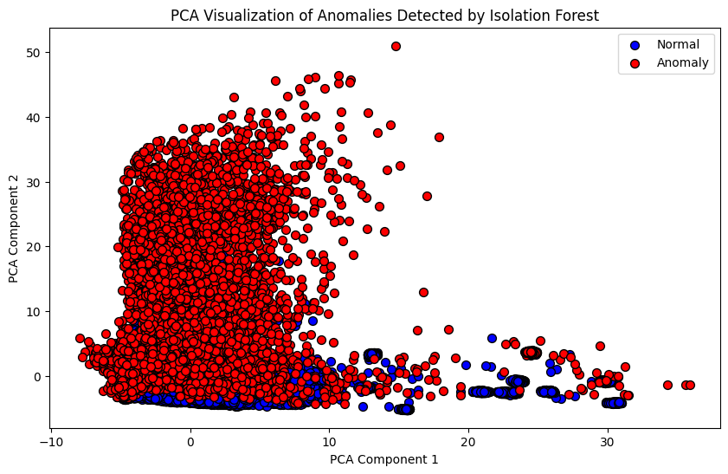

Slide 38
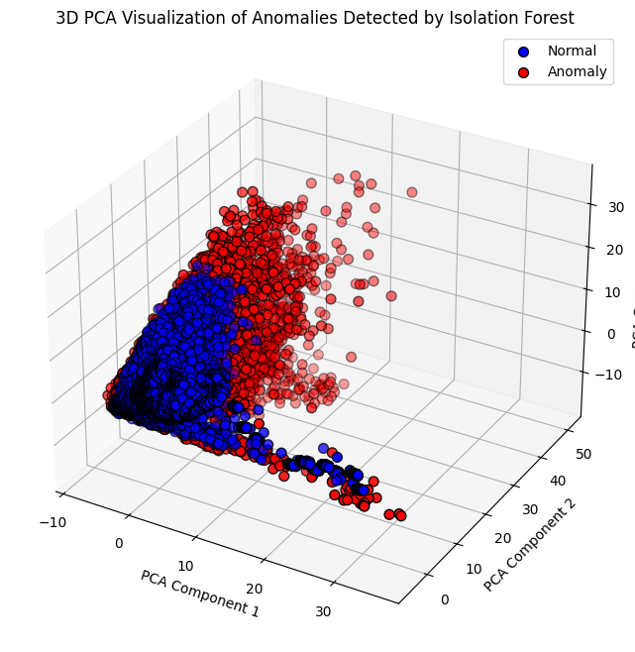

Slide 39
Limitations
Small data sample
Based on 2 Inputs
Only 10 subjects
Inputs from a Gyroscope and an Accelerometer placed on the left ankle and right lower arm
Limited to 12 Activities

Slide 40
Conclusions
Machine Learning
Deep Learning
Accurate classifications of activities from accelerometer and gyroscope data
Activity anomaly detection for emergency attention
Notes:
The goal is to create a machine learning pipeline that can process accelerometer and gyroscope data and classify activities accurately, enabling healthcare providers to make informed decisions about patient care.

Slide 41

04
Generative AI
Ziyan
Notes:
Thank you Jeriel. Hi everyone, I am Ziyan, and I will take you through the Generative AI model that we designed for our dataset.

Slide 42
Aim
The goal is to design a user-friendly interface (UI) that enables non-programmers to execute queries easily.
This UI will assist them in reviewing sensor readings or dataset outputs for an initial assessment.
Notes:
As mentioned, our dataset is retrieved by medical personnel for research and review purposes, and there are bound to be non-programmers viewing the dataset. This brings us to the aim: to design a UI enabling quick review of sensor readings for an initial assessment for anyone.

Slide 43




Methodology
Gradio
Used for the User Interface (UI) to ensure usability for non-programmers.
Langsmith
Tracing and debugging tool for LangChain workflows.
LangGraph
A framework to build step-by-step workflows for AI tasks.
Generative AI (GPT-4)
Generates SQL queries and human-readable answers.
Notes:
Here is our approach: We used GPT4 to generate SQL queries and human-readable answers. For example, if one asks how many components are there in the dataset, GPT 4 translates it to a valid query like SELECT distinct labels from Mhealth db. Then we used Langraph framework to build step-by-step workflows for AI tasks, Langsmith for debugging, and Gradio for a simple user interface.

Slide 44

Notes:
Here’s a demo querying “What is the highest reading of alx for subject 7?” The SQL query is generated and processed, delivering the final answer seamlessly.
Slide 42: This system aids researchers by quickly retrieving results without programming knowledge.

Slide 45
Limitation and Future Improvements
Complex Queries
Error Handling
Database Schema Limitations
Execution Risks
Notes:
However, limitations include difficulty handling multi-table queries, potential syntax errors from GPT-4, reliance on accurate schema information, and execution risks like long-running queries or security issues.
To improve, we can fine-tune GPT-4 with subqueries, validate queries using SQL parser, automate schema checks to handle incomplete metadata, improve accuracy, and enhance security with read-only database access.

Slide 46
Limitation and Future Improvements
Fine Tune GPT 4
SQLparser
Automated Schema Checks
Read-
Only Database
Notes:
To improve, we can fine-tune GPT-4 with subqueries, validate queries using SQL parser, automate schema checks to handle incomplete metadata, improve accuracy, and enhance security with read-only database access.

Slide 47
Thank you!
Notes:
And that brings me to the end of our presentation, we hope our models will streamline sensor data analysis and make data exploration accessible to non-programmers.

Slide 48
Resources & References
Dataset Information
MHEALTH Dataset Data Set CSV | Kaggle
Reference Code for Modeling
Mhealth Classification by Cole Bryant

Slide 49
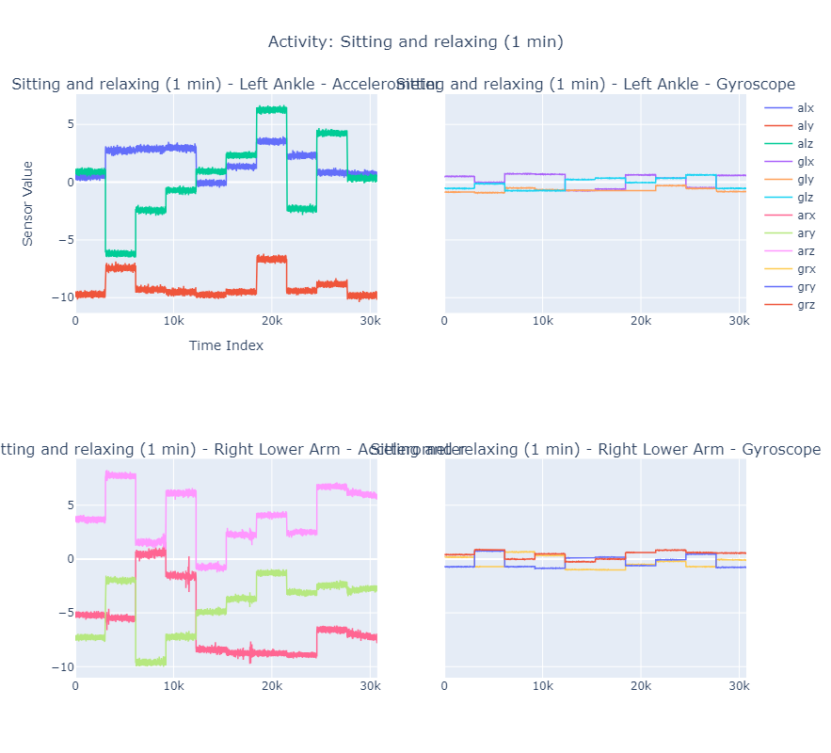
Standing Still
Sitting and Relaxing

Slide 50
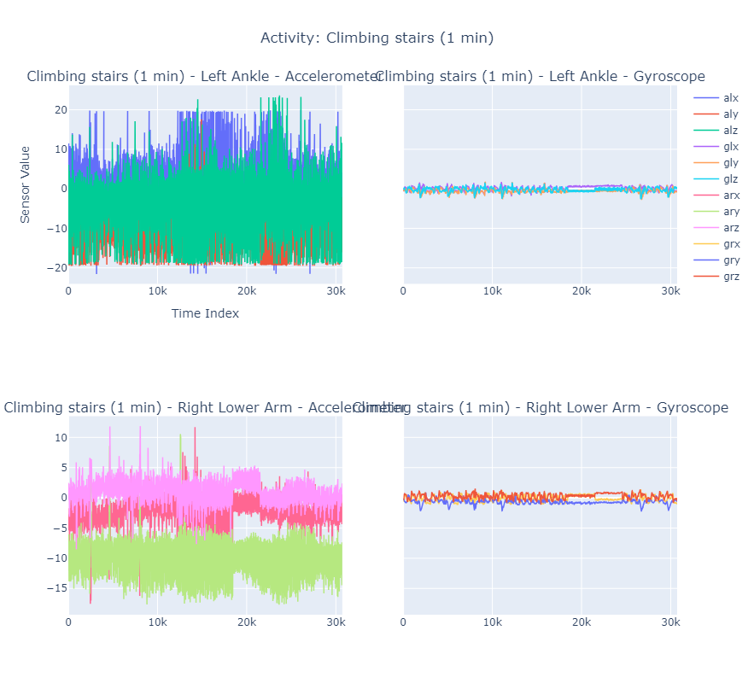
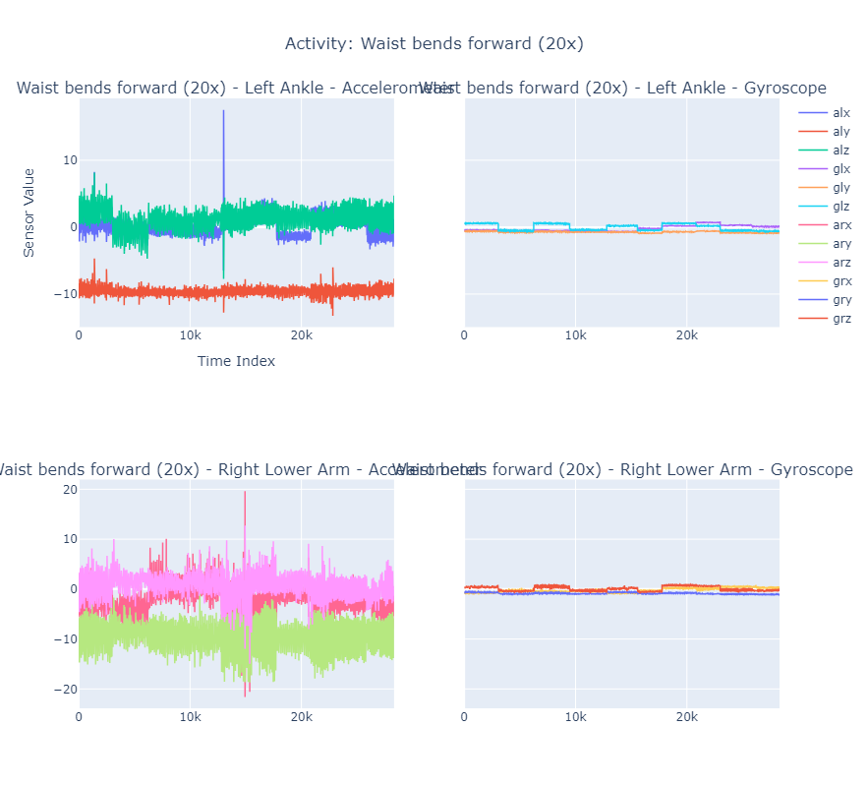
Climbing Stairs
Waist Bends Forward
Notes:
def plot_comparison_part2(df):
"""Plots the second half of activities (7 to 12)."""
for i in range(6, 13): # Loop through activities 7 to 12
# Filter data for the current activity
activity_data = df[df['Activity'] == i]
# Check if there is no data for the current activity
if activity_data.empty:
print(f"No data available for Activity {i}. Skipping.")
continue
# Create a subplot for the current activity
com_fig = make_subplots(
rows=2, cols=2,
subplot_titles=[
f'{activity_map.get(i, f"Activity {i}")} - {sensor_name}' for sensor_name in sensors.keys()
],
shared_yaxes=True
)
for idx, (sensor_name, columns) in enumerate(sensors.items()):
row = (idx // 2) + 1
col = (idx % 2) + 1
for column in columns:
com_fig.add_trace(go.Scatter(
x=activity_data.reset_index(drop=True).index,
y=activity_data.reset_index(drop=True)[column],
mode='lines',
name=column,
line=dict(width=1.5)
), row=row, col=col)
# Update layout for each subplot
com_fig.update_layout(
title=f'Activity: {activity_map.get(i, f"Activity {i}")}',
title_x=0.5,
height=800,
xaxis_title='Time Index',
yaxis_title='Sensor Value',
showlegend=True
)
# Show the plot
com_fig.show()
plot_comparison_part2(df)

Slide 51
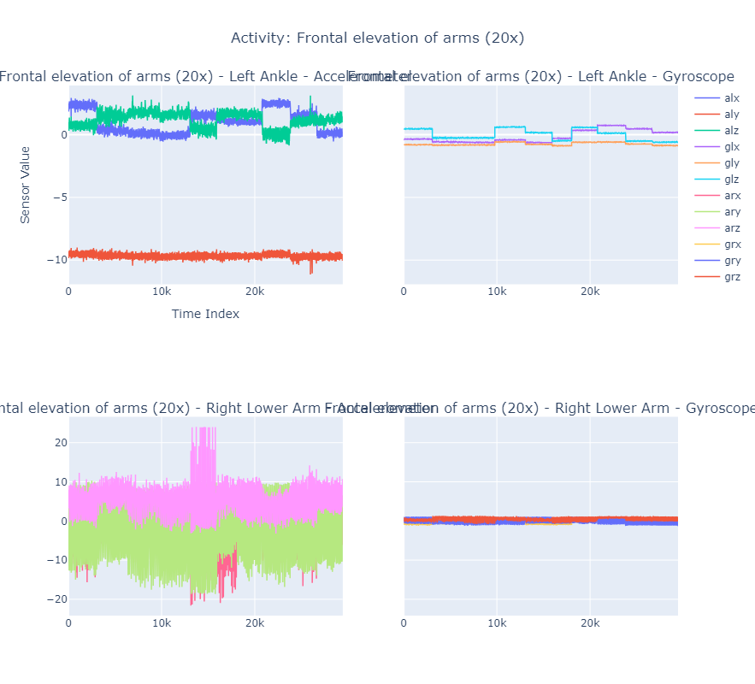
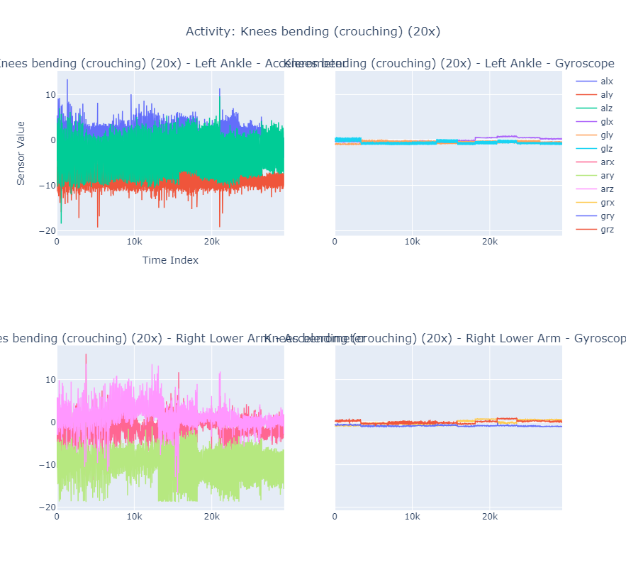
Frontal Elevation of Arms
Crouching

Slide 52
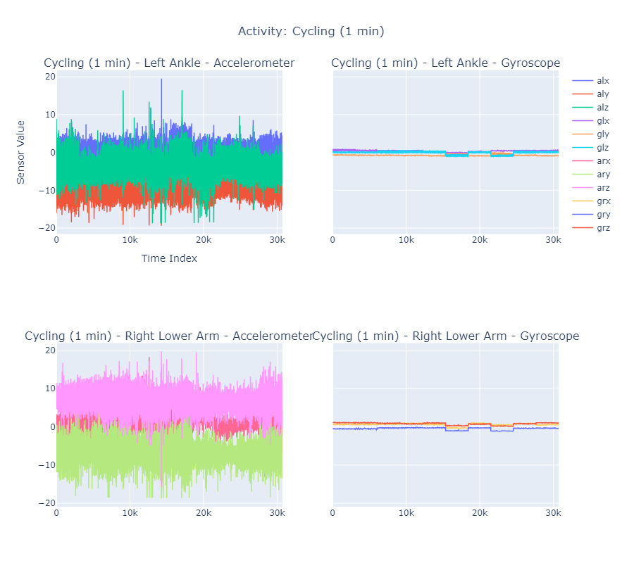
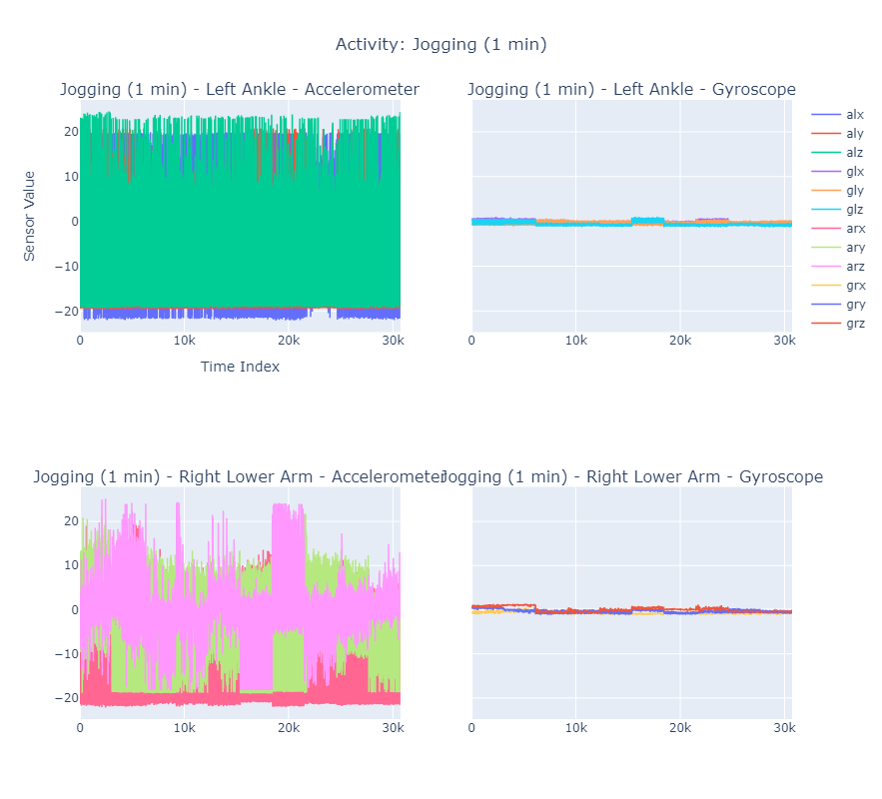
Cycling
Jogging
Notes:
def plot_comparison_part1(df):
"""Plots the second half of activities (0 to 5)."""
# Define sensor groups for visualization
for i in range(0, 6): # Loop through activities 0 to 5
# Filter data for the current activity
activity_data = df[df['Activity'] == i]
# Check if there is no data for the current activity
if activity_data.empty:
print(f"No data available for Activity {i}. Skipping.")
continue
# Create a subplot for the current activity
com_fig = make_subplots(
rows=2, cols=2,
subplot_titles=[
f'{activity_map.get(i, f"Activity {i}")} - {sensor_name}' for sensor_name in sensors.keys()
],
shared_yaxes=True
)
for idx, (sensor_name, columns) in enumerate(sensors.items()):
row = (idx // 2) + 1
col = (idx % 2) + 1
for column in columns:
com_fig.add_trace(go.Scatter(
x=activity_data.reset_index(drop=True).index,
y=activity_data.reset_index(drop=True)[column],
mode='lines',
name=column,
line=dict(width=1.5)
), row=row, col=col)
# Update layout for each subplot
com_fig.update_layout(
title=f'Activity: {activity_map.get(i, f"Activity {i}")}',
title_x=0.5,
height=800,
xaxis_title='Time Index',
yaxis_title='Sensor Value',
showlegend=True
)
# Show the plot
com_fig.show()
plot_comparison_part1(df)

Slide 53
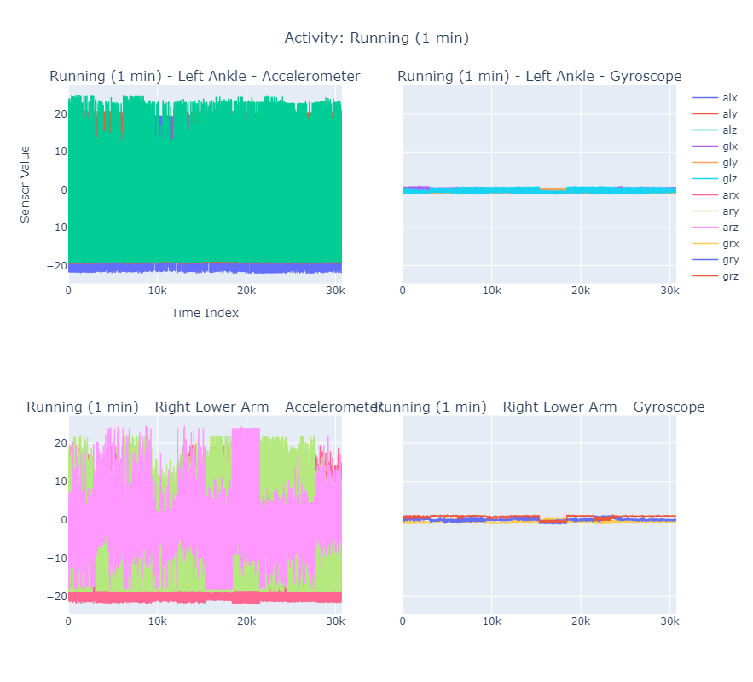
Running
Jump Front & Back

Slide 54
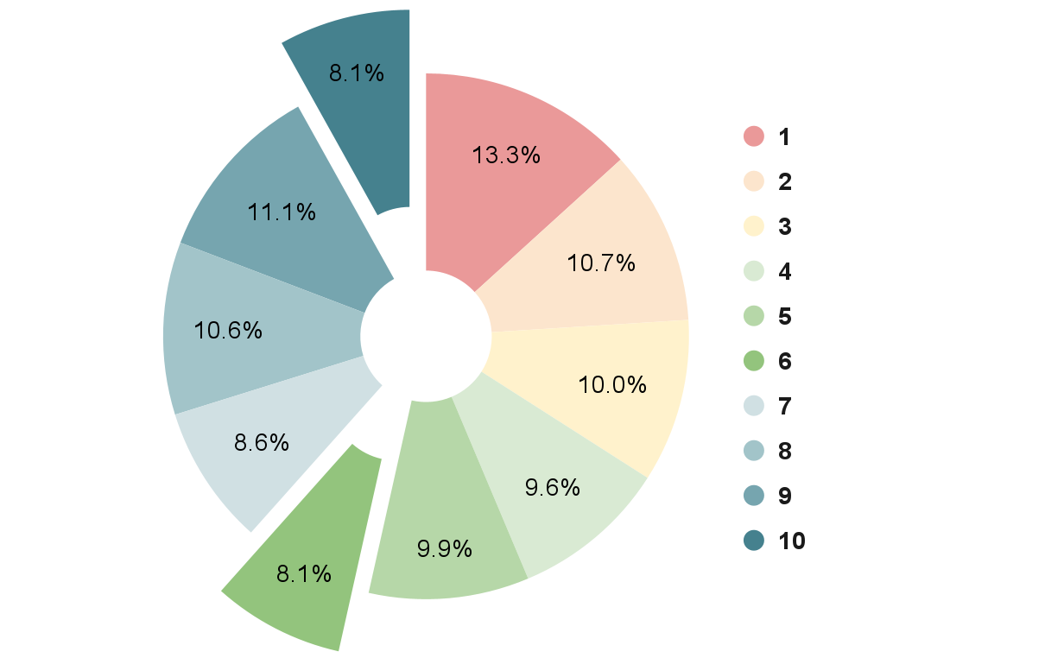
Distribution of Subject Observations
Subjects 6 & 10 participated in the least number of activities whilst Subject 1 participated in the most
Notes:
Subject 6 and 10 having the lowest observation,
Subject 1 having the most observations

Slide 55
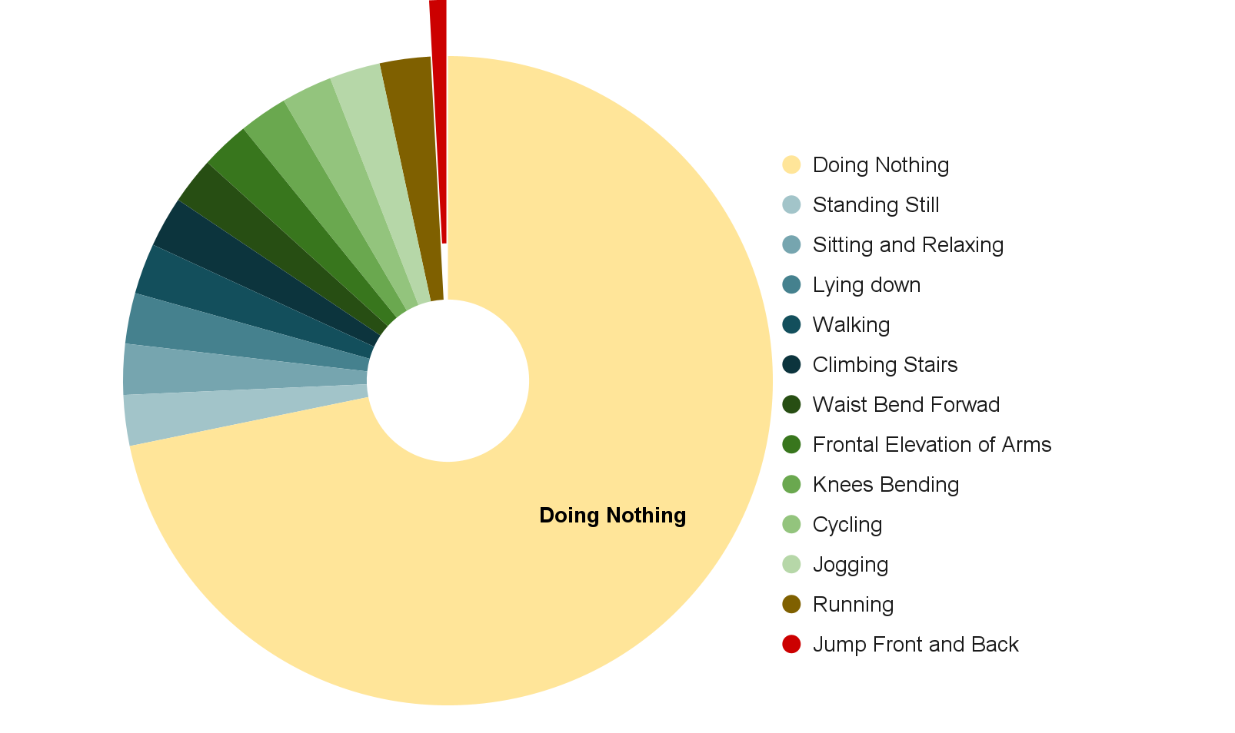
Distribution of Activity Observations

